Slide 1
Teensy Audio Library
(int16 data)
OpenAudio Library
(float32 data)
audio_block_t
audio_block_f32_t
AudioStream
AudioStream_F32
AudioConnection
AudioConnection_F32
allocate()
allocate_F32()
AudioConvert_I16toF32
AudioConvert_F32toI16
AudioEffectXXXX
AudioEffectXXXX_F32

Slide 2
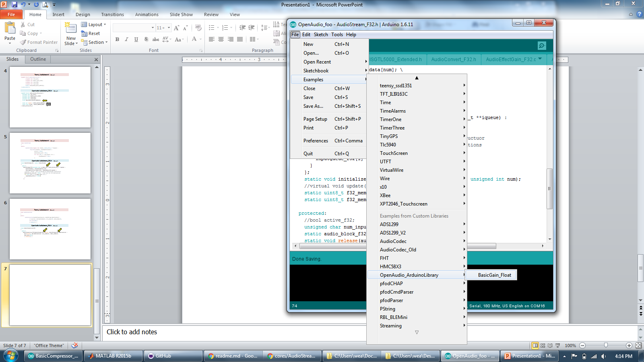

Slide 3
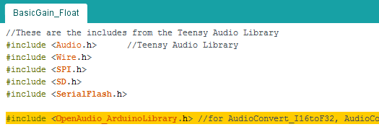
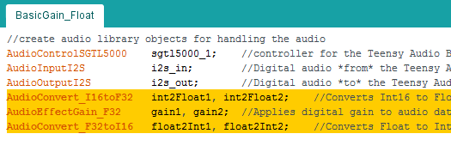
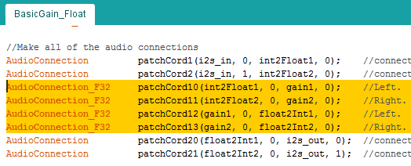
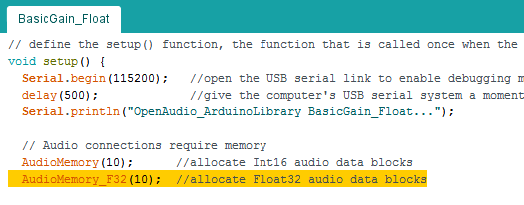

Slide 4
Old Stuff…

Slide 5
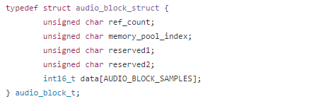
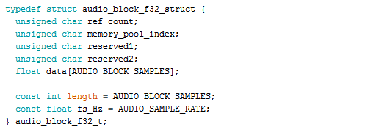
Teensy AudioStream.h (Excerpt)
OpenAudio AudioStream_F32.h (Excerpt)

Slide 6
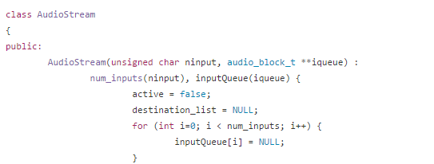
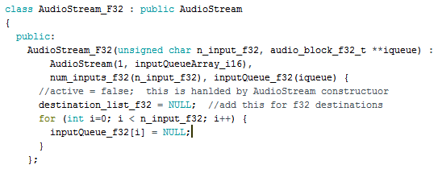
Teensy AudioStream.h (Excerpt)
OpenAudio AudioStream_F32.h (Excerpt)

Slide 7
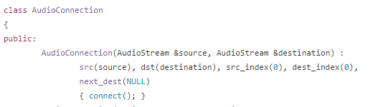
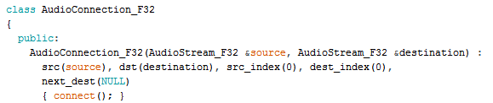
Teensy AudioStream.h (Excerpt)
OpenAudio AudioStream_F32.h (Excerpt)

Slide 8
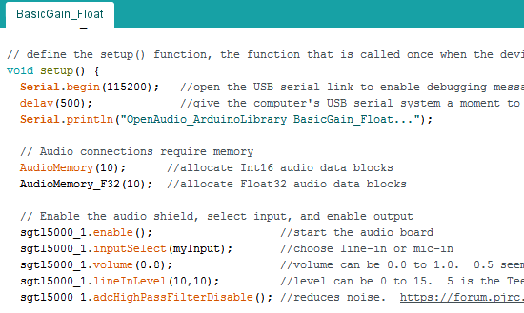

Slide 9
